Slide 1
Water Quality Prediction
Project Mentor :
Prof. Arnab Chakraborty
Team Members :
Aritra Nandy
Bikram Roy
Deep Mondal
Sanjib Mondal
Sudip Chatterjee

Slide 2

Contents
Project Objective & Scope
Data Description
Methodology
Data Preprocessing
Models Used
Accuracy Comparison
Future Scope of Improvements

Slide 3
Project objective & scope
Objective:
Given : A small Water Quality Prediction dataset taken from Kaggle.
Goal : To Predict whether water will be potable or not.
Finally : Apply on the test dataset and compare the differences in the results.
Scope :
It is a useful project as the Classifier models can be used to quickly determine the Water Quality status of large datasets.
The results might have some mismatch with the real-world applications. But that can be avoided if the models are trained for small datasets.

Slide 4
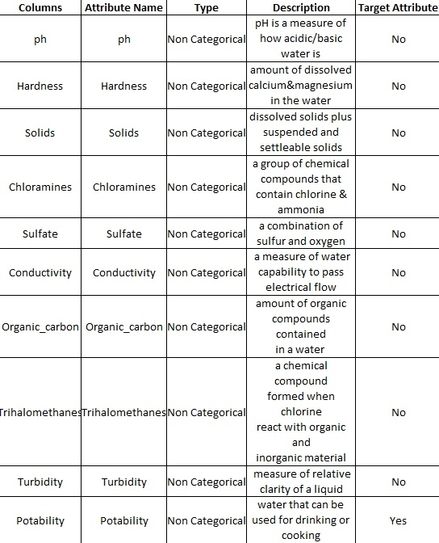
Data description
The description of the data with type and description of each Attribute is given/shown in the table.

Slide 5
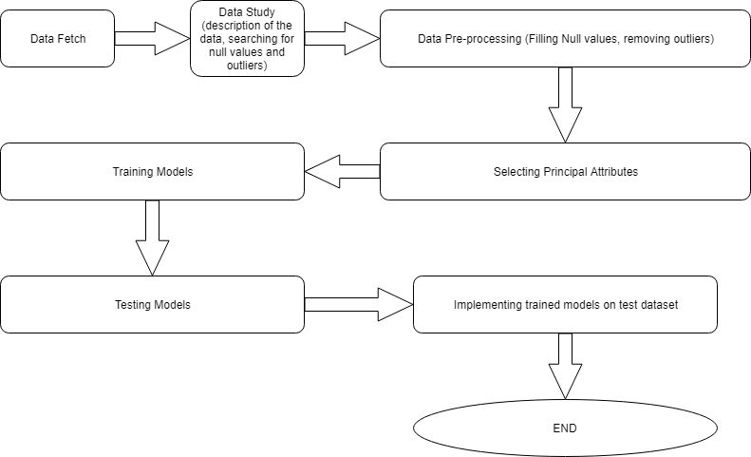
Methodology

Slide 6
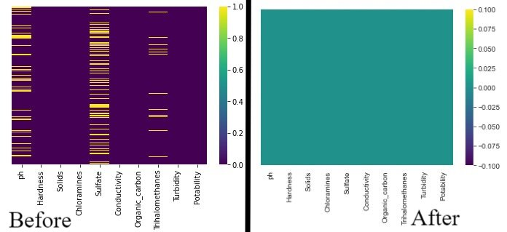
Data Preprocessing
We handled null values and NAN (not a number) values.

Slide 7
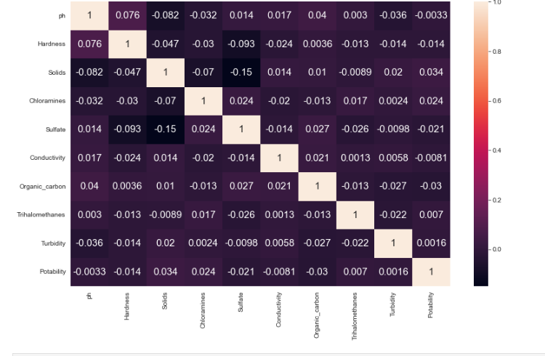
Hit map Matrix

Slide 8
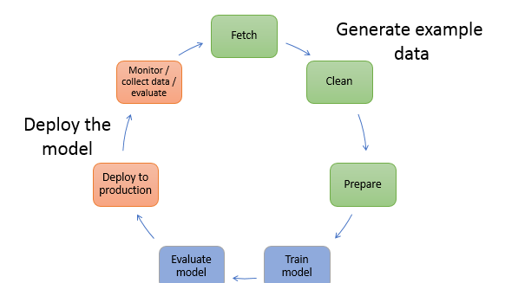
ModelS used
The Machine Learning models used for this project are:
Regression ( Logistic )
KNN Model
Decision Tree
KNN Classification (Using Euclidian Distance)

Slide 9
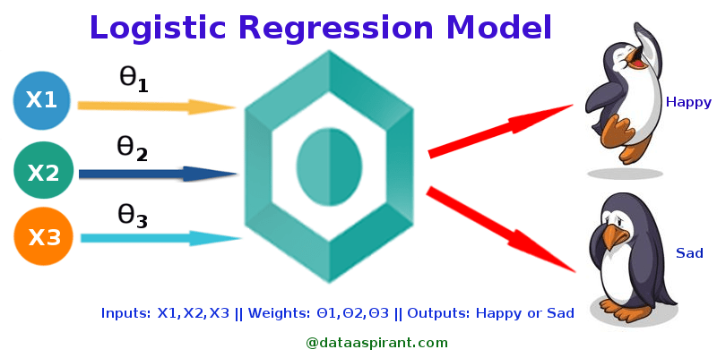
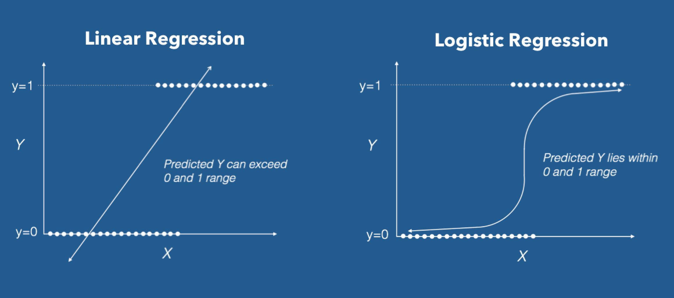
Logistic regression
Logistic Regression is the appropriate regression analysis to conduct when the dependent variable is dichotomous (binary). Like all regression analyses, the logistic regression is a predictive analysis. Logistic regression is used to describe data and to explain the relationship between one dependent binary variable and one or more nominal, ordinal, interval or ratio level independent variables.

Slide 10
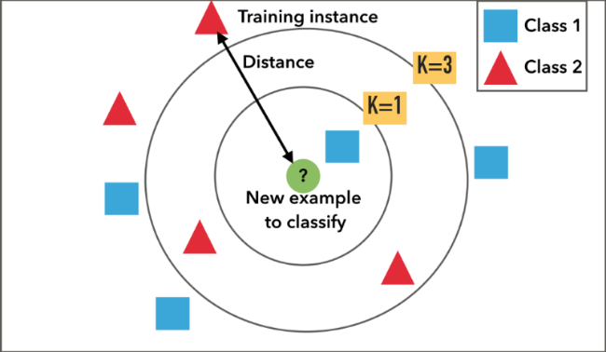
K – nn Classification
A k-nearest-neighbor algorithm, often abbreviated k-nn, is an approach to data classification that estimates how likely a data point is to be a member of one group or the other depending on what group the data points nearest to it are in.
The k-nearest-neighbor is an example of a "lazy learner" algorithm, meaning that it does not build a model using the training set until a query of the data set is performed.

Slide 11
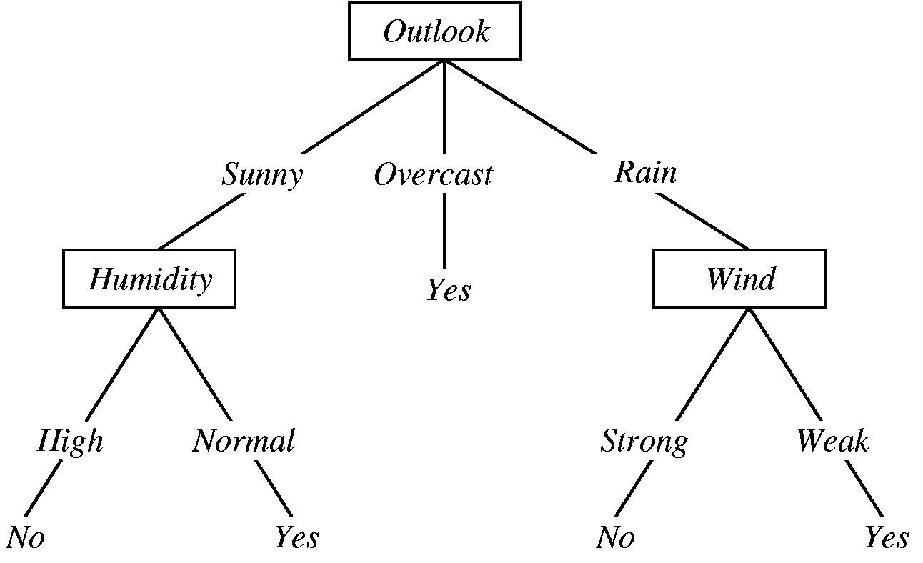
Decision tree
A decision tree is a graphical representation of specific decision situations that are used when complex branching occurs in a structured decision process. A decision tree is a predictive model based on a branching series of Boolean tests that use specific facts to make more generalized conclusions.
The main components of a decision tree involve decision points represented by nodes, actions and specific choices from a decision point. Each rule within a decision tree is represented by tracing a series of paths from root to node to the next node and so on until an action is reached.

Slide 12
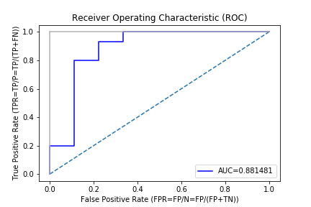
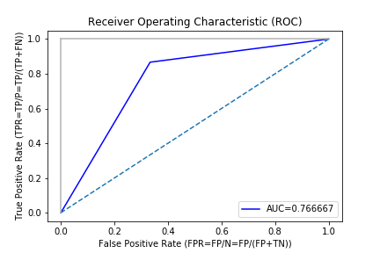
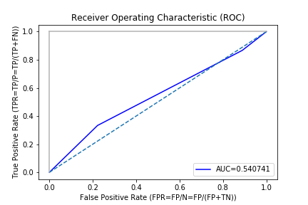
Receiver Operating characteristIc curves
Logistic Regression
Decision Tree
KNN

Slide 13
Accuracy comparison
Models Used | Accuracy %
Logistic Regression | 61.343
Decision Tree | 58.232
K – Nearest Neighbor | 61.738
The data shown above is an average of multiple test runs.
We see that the highest accuracy for the train dataset is K – Nearest Neighbor.
So we can select K – Nearest Neighbor model to predict the test dataset.

Slide 14
Future scope of improvements
This Project can be used to control water pollution.
Monitoring water quality is very important for maintaining ecosystem health and the livelihood of the population.
Mismatches can be removed which had high correlation value but low feature importance.
In future we can check the water quality using many other models for better accuracy.

Slide 15
Thank you
Asansol Engineering College
Prof. Arnab Chakraborty ( arnabchak@gmail.com )

